Slide 1
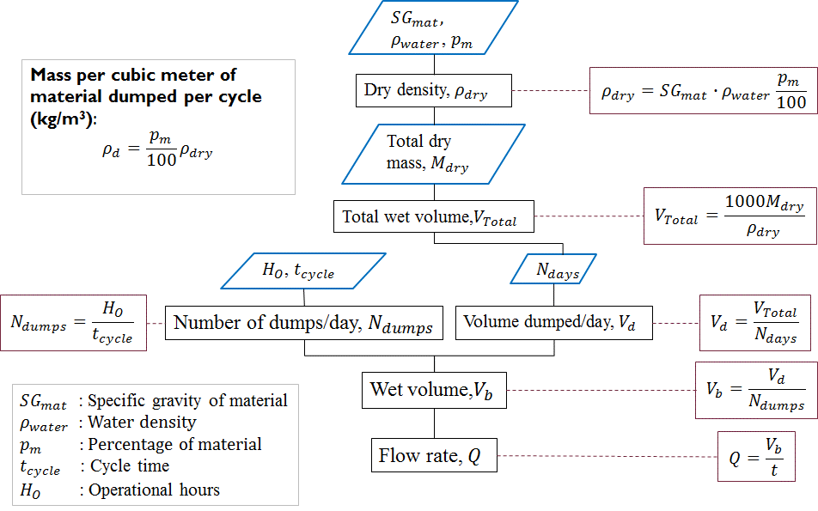
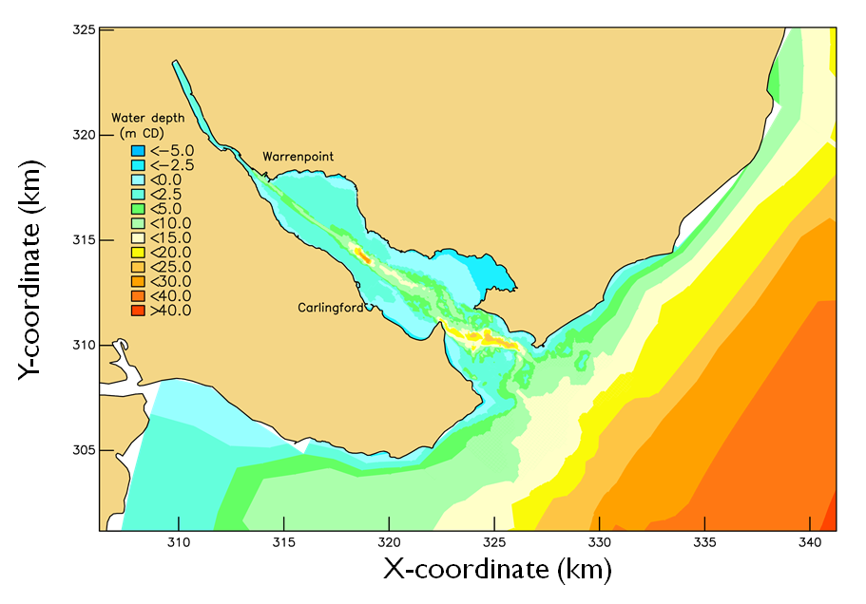
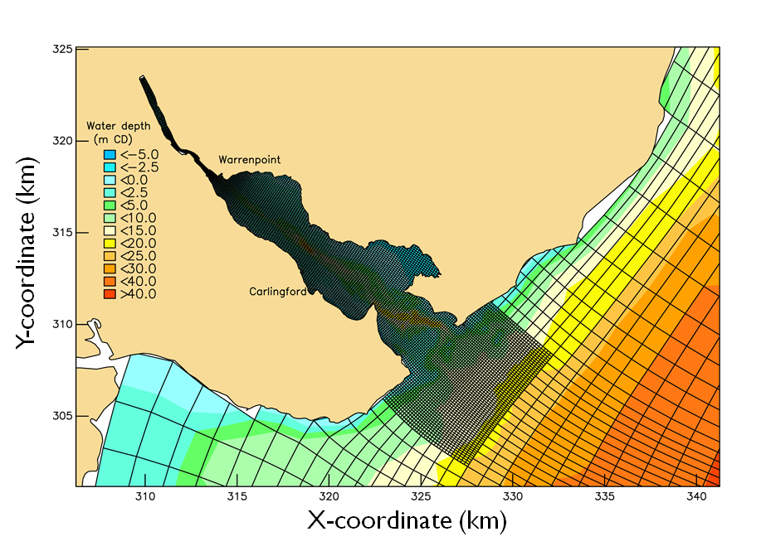
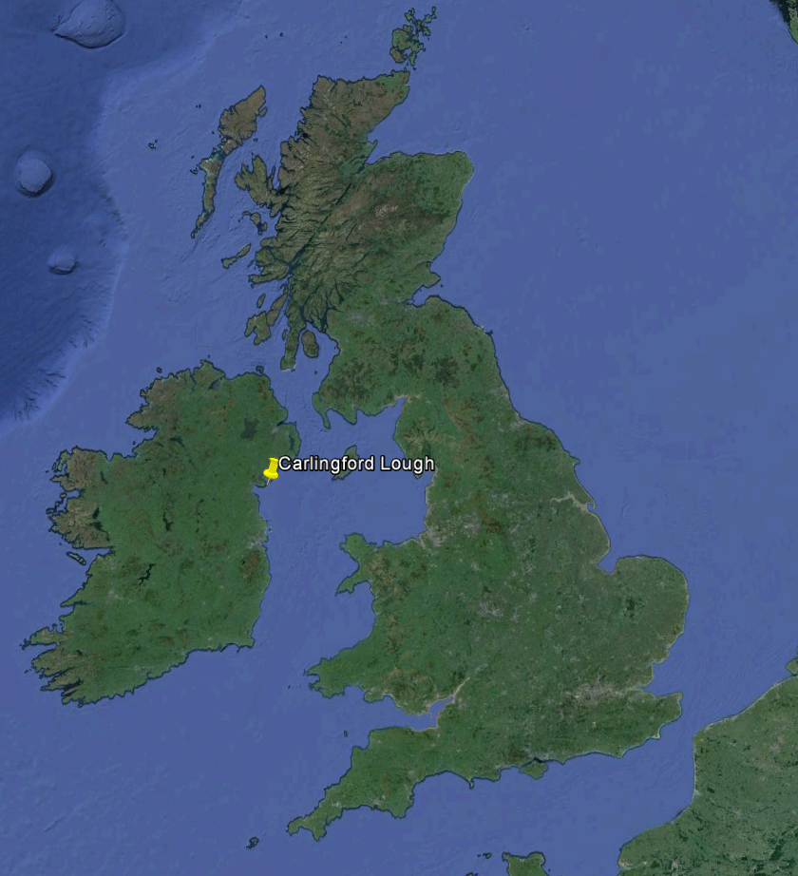
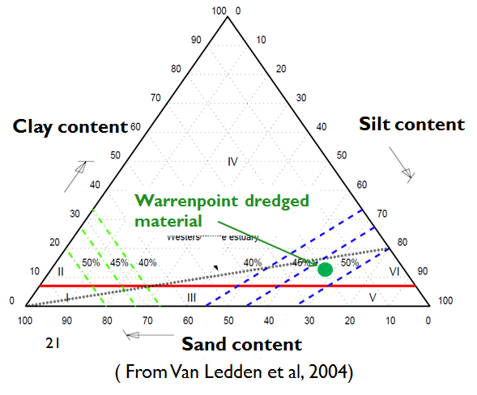
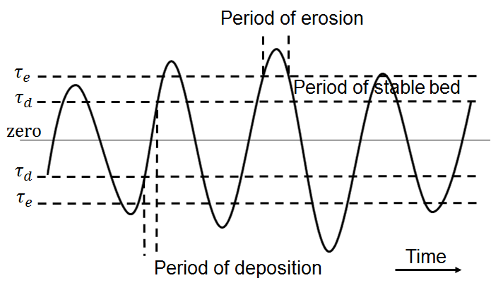
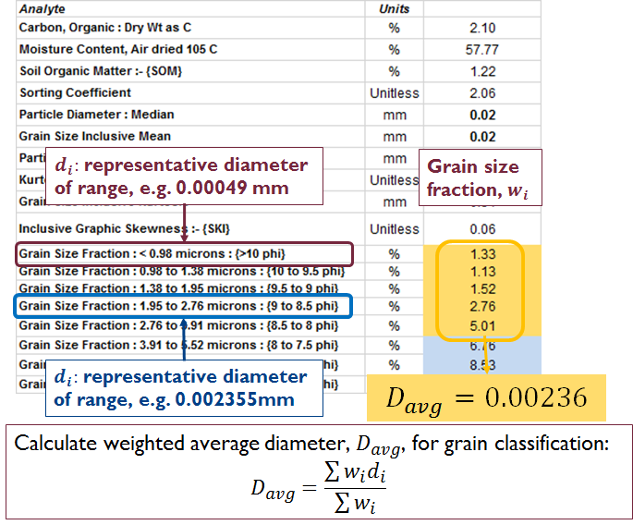
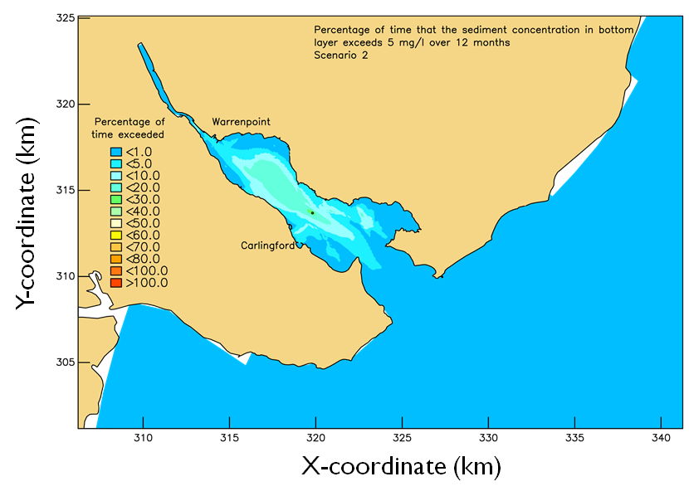
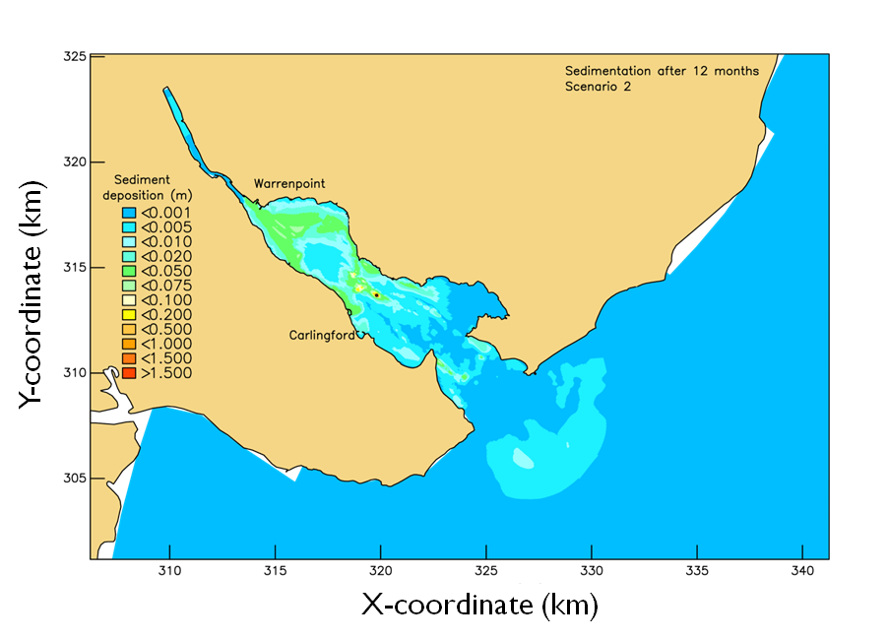

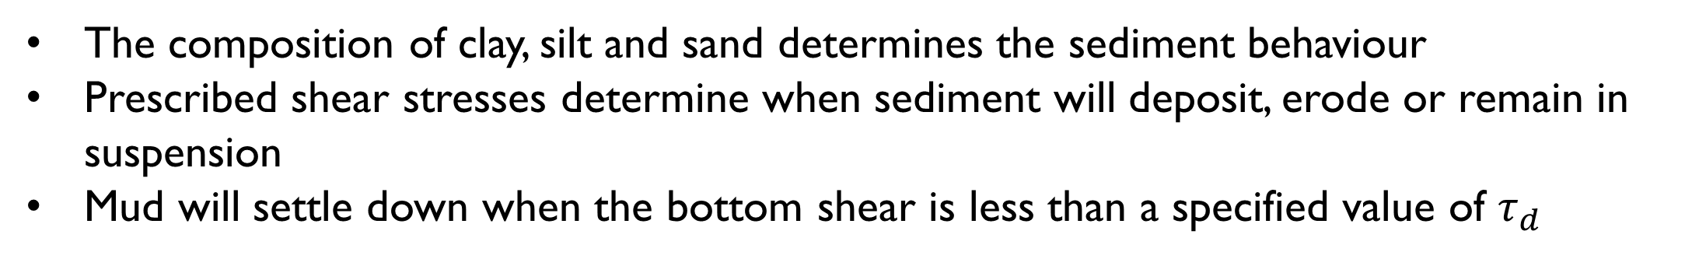
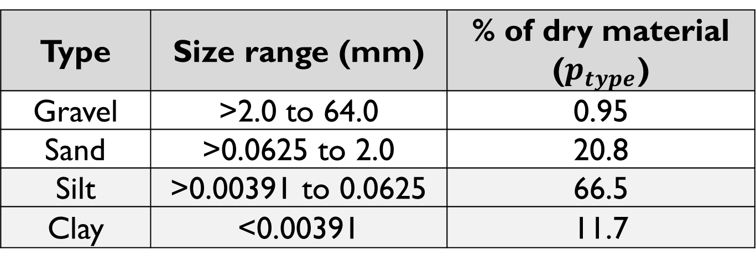
Hydrodynamic and sediment transport modelling to evaluate dredge disposal sites
Hardus Diedericks and Francois Smit
Department of Mathematical Sciences, Division of Applied Mathematics, Stellenbosch University, Private Bag X1, Stellenbosch, 7602, South Africa. Tel: +27 21 8084219, email: fsmit@sun.ac.za
1. Problem statement
4. Pre-processing: Sediment data (continue)
Routine dredging is conducted
Consider alternative dredging schedules to minimise costs
Dumped material should not affect mariculture activities
Types of material to be dredged
Type | Size range (mm) | % of dry material ($p_{type}$)
Gravel | >2.0 to 64.0 | 0.95
Sand | >0.0625 to 2.0 | 20.8
Silt | >0.00391 to 0.0625 | 66.5
Clay | <0.00391 | 11.7
2. Numerical modelling approaches
Problem to be solved will determine:
The type of model
The relevant processes
Need data about processes to:
Adequately describe the drivers and parameters
Intelligent post-processing
Do statistical analyses, e.g. percentiles, averages, exceedences
Flow diagram illustrating the process for converting input data to model input
3. Case study: Carlingford Lough
5. Numerical modelling
General project description:
Evaluate dispersion and deposition of dumped dredged material for different dredge volumes and dump locations
Requirements for the sediment modelling component:
Require dredge schedules and dumping rates
Sediment volumes and composition
Input to other studies
Results must inform ecological studies
Hydrodynamic modelling requires bathymetry
The simulations use two decomposed domains that are interactive
Profile of seabed (depth)
Grid for domain decomposition CFD
The composition of clay, silt and sand determines the sediment behaviour
Prescribed shear stresses determine when sediment will deposit, erode or remain in suspension
Mud will settle down when the bottom shear is less than a specified value of $τ_{d}$
Harbour and potential dump sites
Location
Project dredging specifications
Classification of the type of mud to be dredged
Bottom stresses over tidal cycle
Post-processing evaluates the suspended material against a water quality guideline to safeguard mariculture
4. Pre-processing: Sediment data
The client provides raw data of sediment compositions at dredge and dump sites
The data is converted to input for the numerical simulations
Must comply to project dredging specifications
Scenario 2: Percentage time that the sediment concentration in bottom layer exceeds 5 mg/l over 12 months
Scenario 2: Deposition thickness after12 month
6. Conclusion
Near site dumping allows material to move into the lough
This is therefore not a feasible option
Far site allows material to exit the lough
The dumped material does not affect the mariculture zones

